Slide 1
Design Patterns

Slide 2
Content
Why
What
Patterns

Slide 3
Design Problem to Solve
Why Design Patterns

Slide 4


Without Design
Viscosity: it’s hard to do things right
Rigidity: it’s difficult to change
Fragility: it’s easy to break

Slide 5
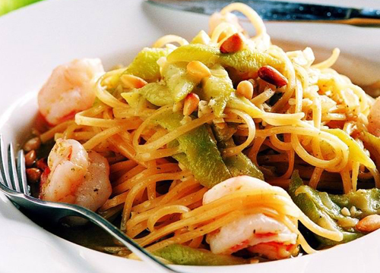
Structural Design

Slide 6

Object Oriented Design

Slide 7
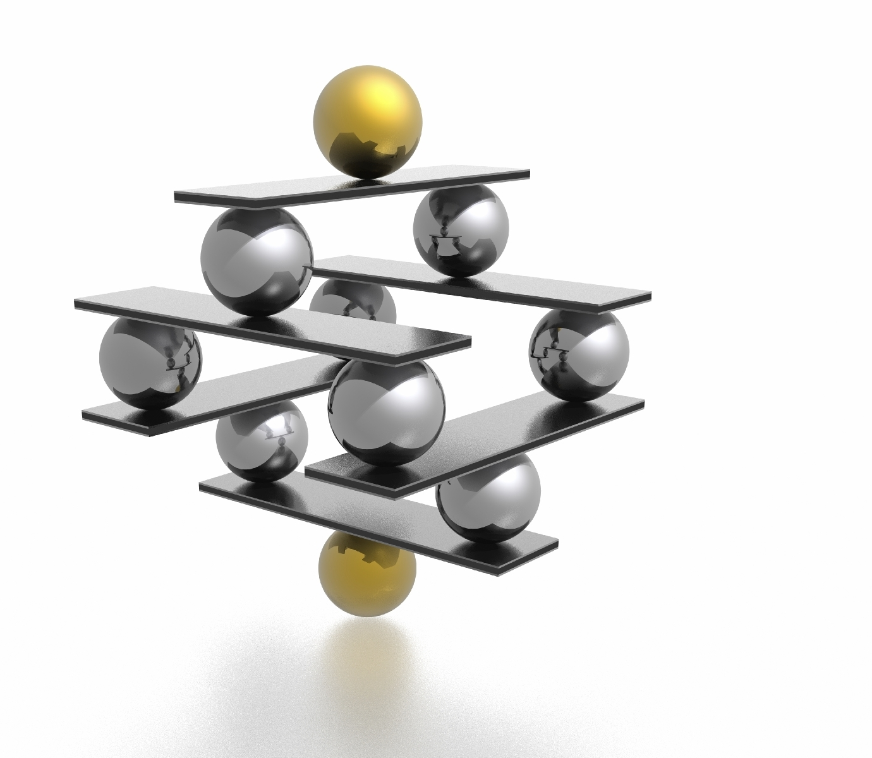
Design Patterns

Slide 8
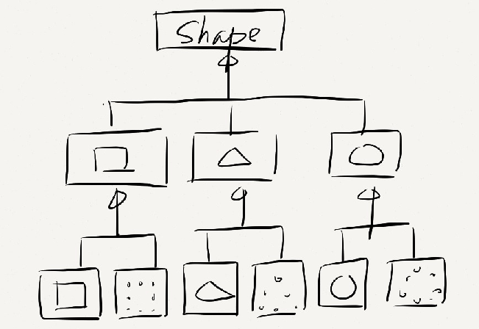
Duplication in class hierarchy

Slide 9
one good thief is worth ten scholars
What is Pattern

Slide 10
Draw a Bridge
1
2
3
4

Slide 11

The Ponte Fabricio in Rome built in 62 BC

Slide 12
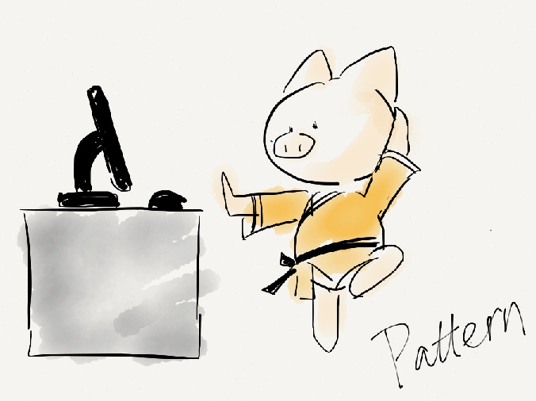
Pattern Language
Name: communication
Problem: relative priorities of the forces
Solution: avoid effort waste on “known” problems

Slide 13
Close look at patterns
Patterns

Slide 14

Strategy Pattern

Slide 15
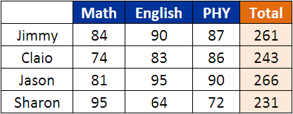

Slide 16
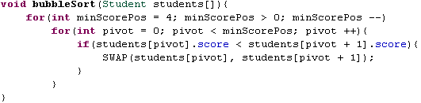

Slide 17
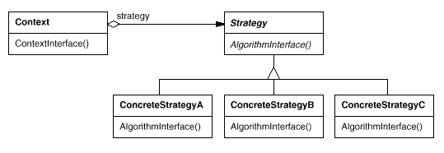

Slide 18

Command Pattern
Command

Slide 19
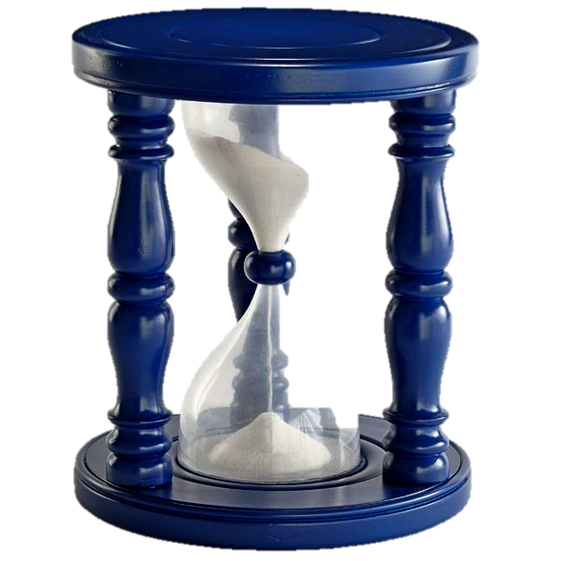
Timer
Time expireTime;
Player player;
Song song;
Timer(Time, Song);
~Timer()
void start();
void expired()
player.play(song);

Slide 20
Client
Invoker
Command
do()
Receiver
ConcreteCommand
action()
do()
Receiver.action()

Slide 21

Decorator Pattern

Slide 22
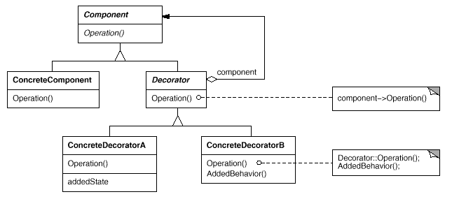

Slide 23

Adaptor Pattern

Slide 24


Switch
Switchable
on
off
Adapter
on
off
on
off
mixing
stop

Slide 25
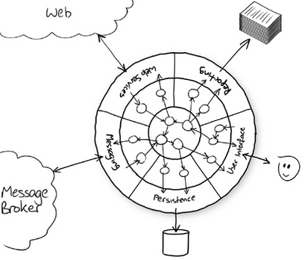
Architecture: Ports and Adapters

Slide 26
Decorator Pattern

Slide 28

Compositor Pattern

Slide 29
printStructC(){
printf(“struct C{\n”);
printf(“ int c = %d\n”, c);
printf(“ struct B{\n”);
printf(“ int b = %d\n”, b);
printf(“ char bb = %c\n”, bb);
printf(“ }\n”);
printf(“ struct A{\n”;
printf(“ int a = %d\n”, a);
printf(“ int aa = %d\n”, aa);
printf(“ }\n”);
printf(“}\n”);
};
struct C{
int c;
struct B{
int b;
char bb;
}
struct A{
int a;
int aa;
}
}

Slide 30
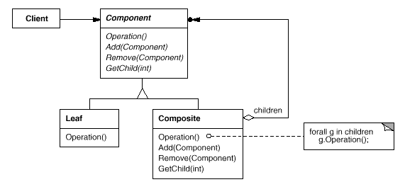

Slide 31

Factory Pattern

Slide 32
Structural
Adaptor
Decorator
Behavioral
Command
Strategy
Creational
Factory

Slide 33

Refactoring to pattern
Encapsulate what varies (SOC)

Slide 34
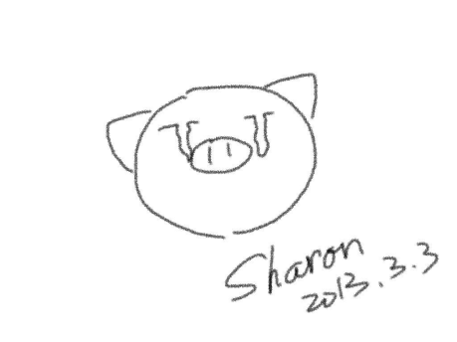
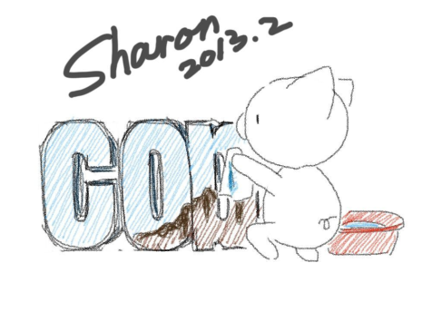
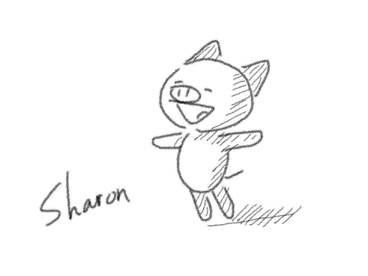

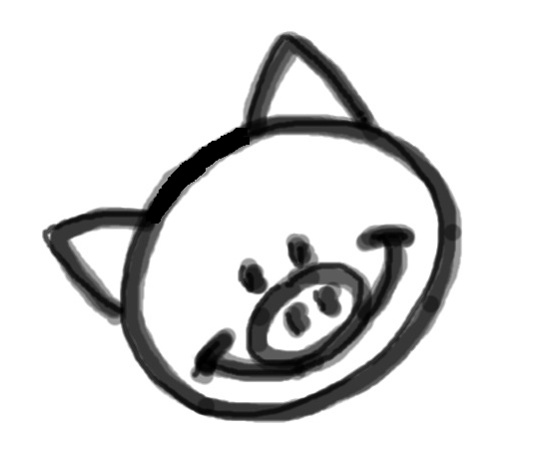
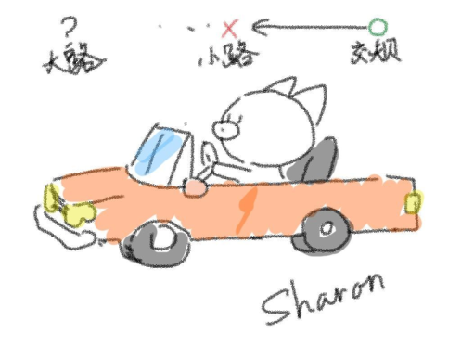
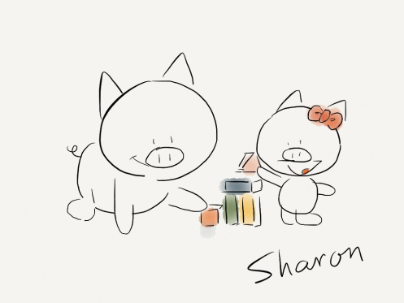

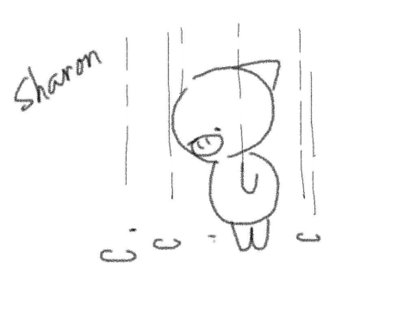
Thank you!
@SharonMei1219

